Slide 1
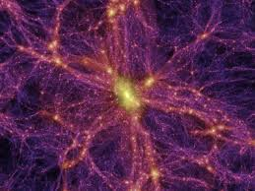
Shape of the Universe
Ryan Broll

Slide 2
Overview
Always referring to “shape” at all times, because of special relativity.
Curvature vs. Topology
  “Flat or curved” vs. “Open or closed”
FLRW model
  Named after scientists
  Assumes Isotropy and Homogeneity of Universe
  “Cosmological Principle”

Slide 3
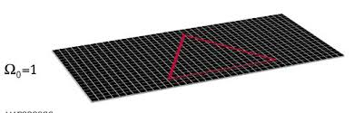
Flat
This ignores minor curvatures caused by bodies with mass
Euclidean, imagine a two dimensional plane
No curvature

Slide 4
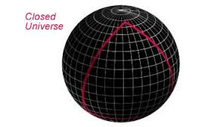
Spherical
3-dimensional hypersphere
WMAP looking for multiple images “back-to-back” of a given object, different in time.
Positive curvature

Slide 5
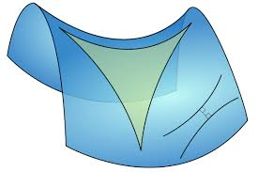
Hyperbolic
3 dimensional analog is a saddle
Parallel lines diverge
Type of “open” Universe with a negative curvature.

Slide 6
Implications about the end of Universe
Flat-Universe continually expands, but the rate of expansion asymptotically approaches zero
Spherical-Eventually expansion stops, reverses, and then collapses into a singularity- “BIG CRUNCH”
Hyperbolic-Universe expands forever

Slide 7
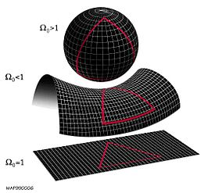
Density
Which one is right?
Depends on Density Parameter (defined as ratio of actual density in the universe to the critical density required to cause expansion to stop)

Slide 8
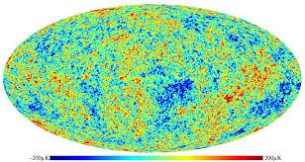
Current Findings
"We now know that the universe is flat with only a 0.4% margin of error” –NASA
Based on WMAP findings
  Wilkinson Microwave Anisotropy Probe
  Still a Hotly Debated Subject

