Slide 1

Faster-than-light Neutrinos Anomaly
Angela Zhang
7/11/14
Theory of Relativity

Slide 2
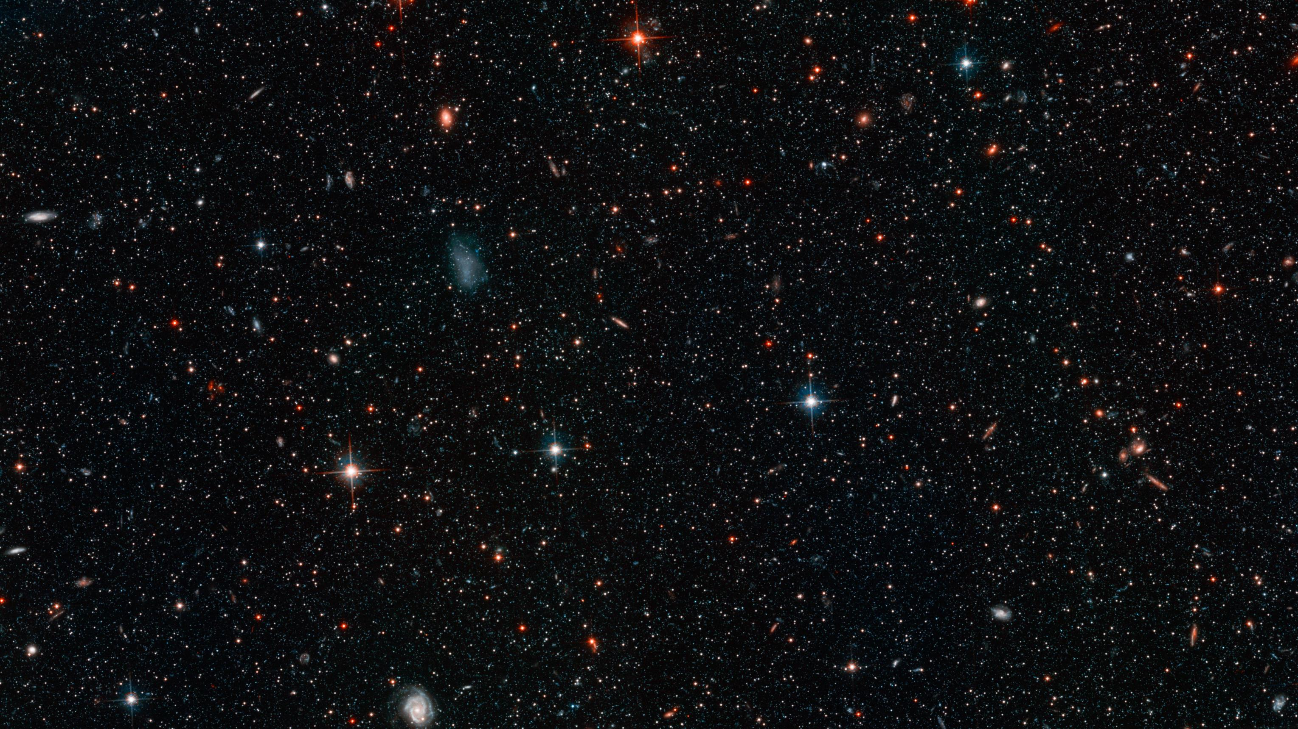
Faster than light?

Slide 3

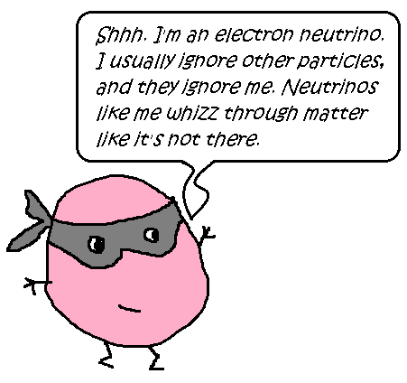

Slide 4

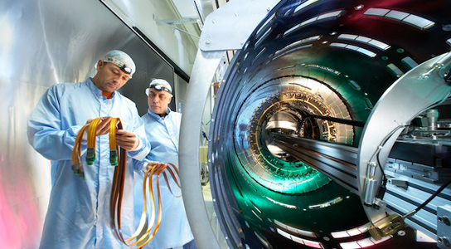
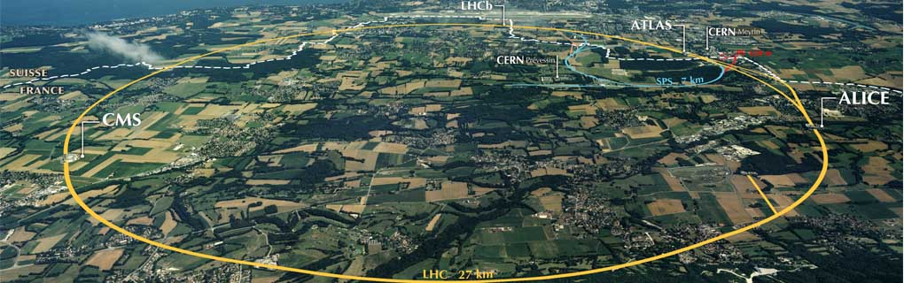
Lab Spots of CERN

Slide 5
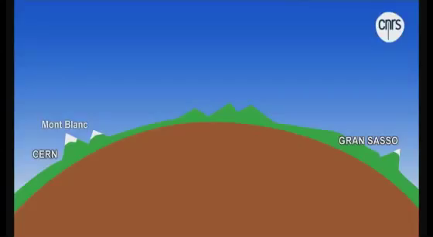

Slide 6
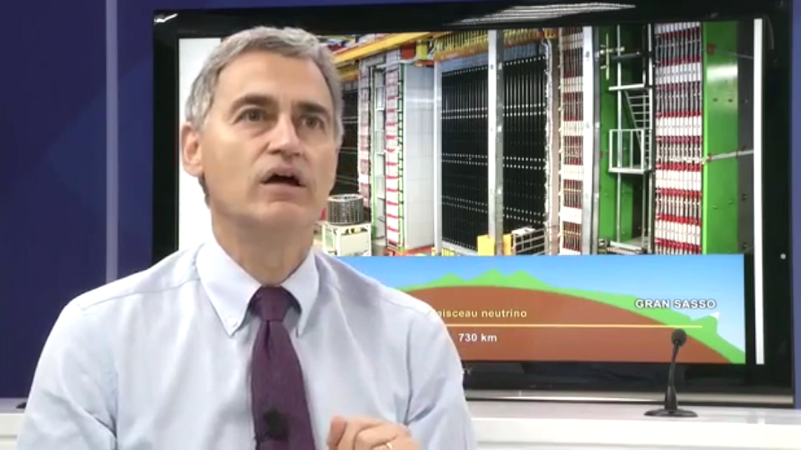
Antonio Ereditato

Slide 7
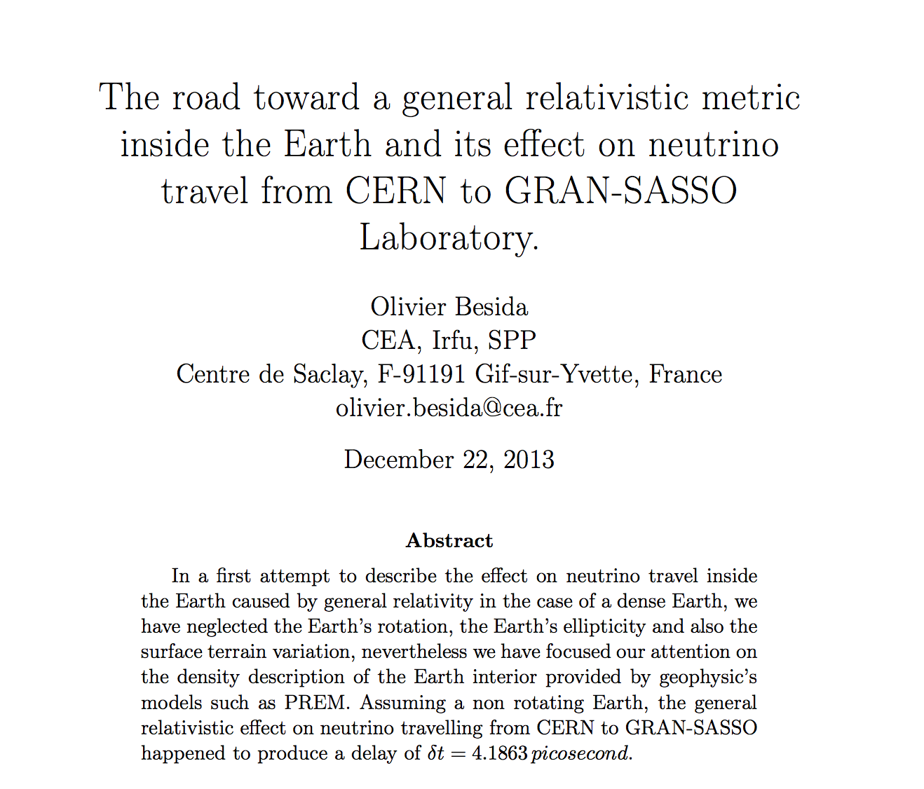
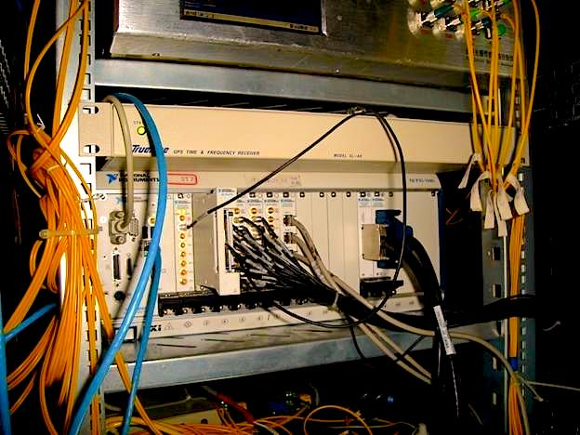

Slide 8
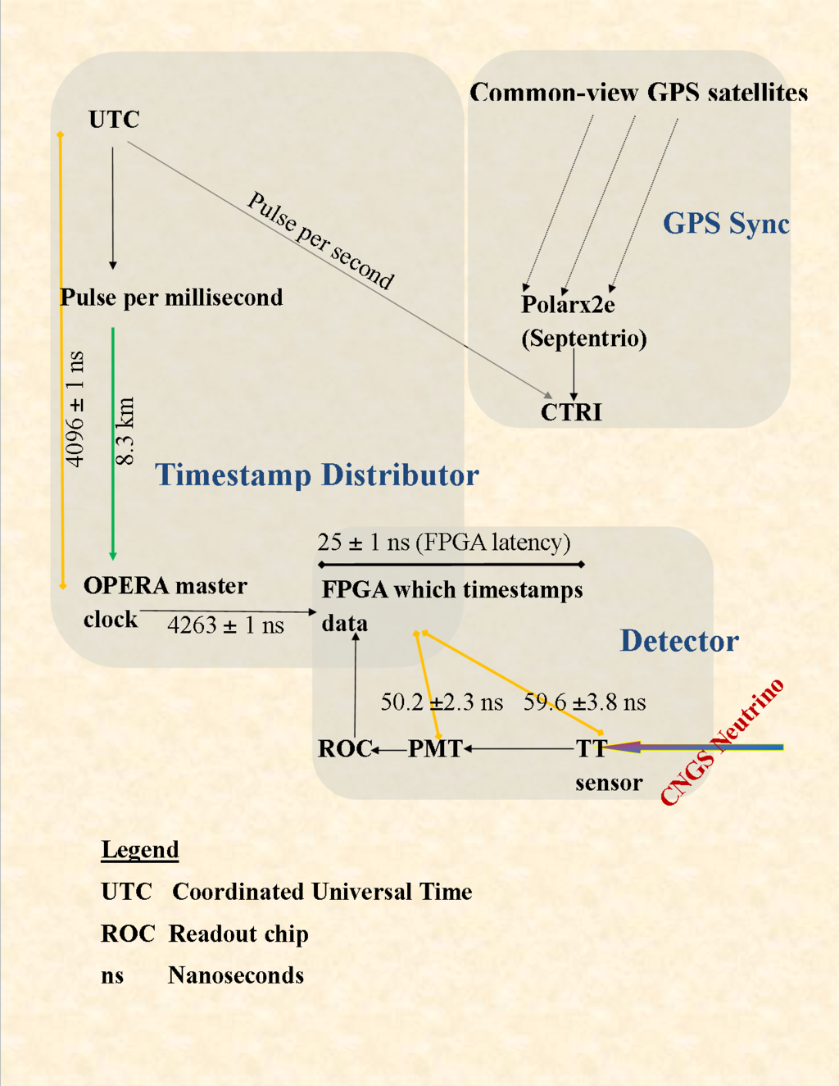

Slide 9
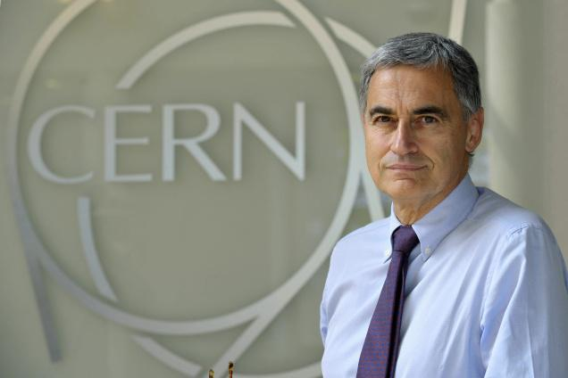

The words “errors”, “mistakes” and “flop” were bandied about regarding what in actual fact is standard scientific procedure in experimental work.
I wish to clarify a number of issues surrounding news of my resignation as Chairman of the OPERA experiment.

Slide 10

✿How to make a Neutrinos beam?

Slide 11
Bibliography
http://arxiv.org/pdf/1205.0930v1.pdf
http://arxiv.org/pdf/1201.4147v1.pdf
http://www.lescienze.it/news/2012/03/30/news/opera_ereditatos_point_of_view-938232/
http://news.sciencemag.org/2012/02/breaking-news-error-undoes-faster-light-neutrino-results
http://press.web.cern.ch/press-releases/2011/09/opera-experiment-reports-anomaly-flight-time-neutrinos-cern-gran-sasso
http://www.bbc.com/news/science-environment-17560379
https://www.youtube.com/watch?v=U_xWDWKq1CM

