Slide 1

CERN
By Owen Lee

Slide 2
History
CERN stands for Conseil Européen pour la Recherche Nucléaire.
The name eventually changed to Organisation Européenne pour la Recherche Nucléaire, but CERN kept the original acronym.
CERN is based in Geneva, Switzerland and has 21 member states in Europe, as well as Israel.

Slide 3
The Large Hadron Collider
CERN’s most famous piece of technology is the Large Hadron Collider (LHC).
The LHC is the most powerful particle collider in the world.
The LHC is designed to collide hadrons, particles created by quarks.
Common hadrons are protons, neutrons, mesons, pions and kaons.

Slide 4
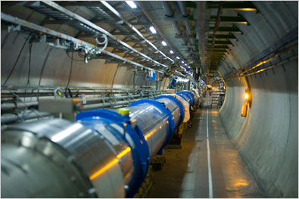
Large Hadron Collider

Slide 5
Other Equipment
CERN possesses:
Two linear accelerators
A proton synchrotron booster
A low energy ion ring
An on-line isotope mass separator
An antiproton decelerator
A compact linear collider

Slide 6
Antimatter Research
Antiprotons are created when the proton synchrotron fires a proton beam into a block of metal.
The antiprotons travel at a speed near c and are passed through clouds of electrons in the antiproton decelerator until their speed is roughly .1c.
CERN has been able to isolate and study three hundred antiatoms for about a thousand seconds.

Slide 7
Antimatter Research
CERN has developed an antiproton beam that is four times more efficient in treating cancer than traditional proton beams.
Proton beams shoot a stream of protons into the body, stopping at the tumor. Upon slowing, major damage is done to nearby cells, including the cancerous cells.
Antiprotons resulted in the annihilation of atoms in cancerous cells which rapidly spread and destroyed nearby cancerous cells.
This was effective enough to require four times less antiprotons as protons, causing less damage to healthy cells.

Slide 8
Controversies
Concerns have risen about the possibility of the LHC creating black holes on Earth.
CERN officials have assured the critics that any black holes created by the LHC would be microscopic and collapse nearly instantly.
Additionally, some have worried about the production of strange matter, hypothetical particles that could theoretically convert others into strange matter.
CERN claims that strange matter would generate an electromagnetic field that would repel surrounding matter.
CERN also claims that strange matter would decay almost instantly.

Slide 9
Controversies
Some critics claim that CERN could create magnetic monopoles in the LHC.
A magnetic monopole is a particle with a single magnetic charge instead of two.
Some fear that magnetic monopoles could pull matter apart due to their uneven charges.
According to CERN, magnetic monopoles do not have this type of destructive capacity, and are in fact eager to create these particles.

Slide 10
Controversies
A third fear is that the LHC will produce large quantities of radiation and extremely high energy collisions.
CERN officials assure the public that the LHC is well shielded by one hundred meters of earth.
Additionally, high-energy cosmic ray collisions are common in nature.

Slide 11
Bibliography
http://en.wikipedia.org/wiki/Cern#Current_complex
http://en.wikipedia.org/wiki/Large_Hadron_Collider
http://home.web.cern.ch/about/accelerators/antiproton-decelerator
http://home.web.cern.ch/topics/antimatter
http://home.web.cern.ch/about/experiments/ace
http://science.howstuffworks.com/science-vs-myth/everyday-myths/large-hadron-collider7.htm
http://en.wikipedia.org/wiki/Strangelets#Dangers
Maxime Agier

