Slide 1
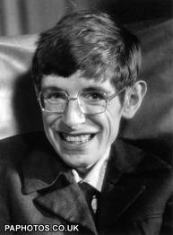
Stephen Hawking
Allie Murphy
July 12, 2013
Theory of Relativity

Slide 2
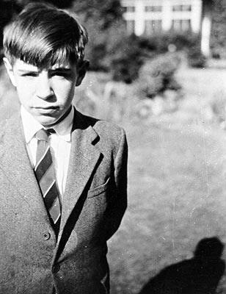
Early life
Born to educated parents on January 8, 1942 in Oxford, England
Initially did not succeed academically
Learned to read at age of 8
Showed an interest and talent for mathematics, mechanical work, and physics
At the age of 21, diagnosed with motor neurone (Lou Gehrig’s) disease, which rapidly weakens muscles and debilitates speaking and breathing systems

Slide 3
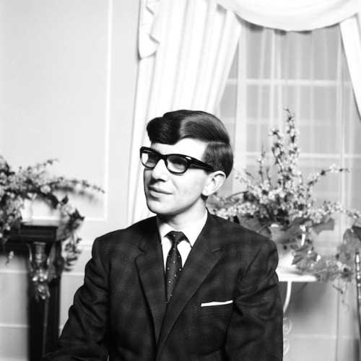
education
Attended Oxford University in 1959 at the age of 17, where he studied physics and chemistry
Three years later he graduated and began studying cosmology at the University of Cambridge
Specifically interested in general relativity and theoretical physics
Wrote his graduate thesis on the theory of space-time singularities existing throughout the entire universe
His essay – “Singularities and the Geometry of Space-Time” – received high praise
Received his Ph.D. in 1966

Slide 4
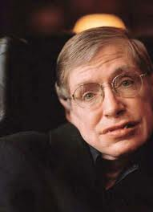
career
Collaborated extensively with Robert Penrose (another advocate of the singularity theorem)
In 1970, they together published a proof asserting that given the universe obeyed the rules of general relativity, it must have originated as a singularity
In 1973, Hawking began studying quantum gravity and quantum mechanics
Appointed a professor in gravitational physics in 1977
Became involved in the study of cosmological inflation in the ’80’s
Consistently studies the origins of the universe

Slide 5
Notable theories and Achievements
Discovered the “second law of black hole dynamics” (later proven wrong)
Proposed the four laws of black hole mechanics
Studied “Hawking radiation”
In 1979 proposed “N=8 Supergravity”
In 1981 became a strong proponent of the “black hole information paradox”
With Jim Hartle published a model known as the “Hartle-Hawking state” in 1983
1985 proposition of “backwards time”
In 2006 developed the theory of “top-down cosmology”

Slide 6
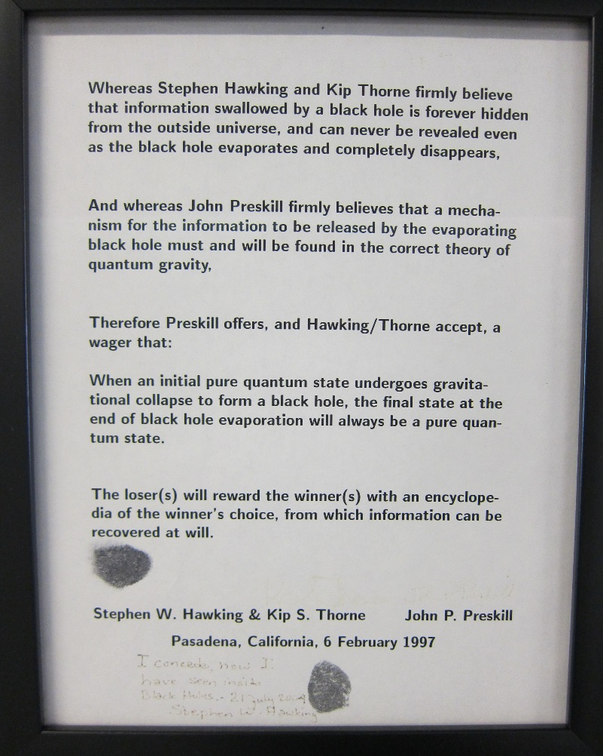
Famous hawking wagers
1974. Bet Kip Thorne that the dark star Cygnus X-1 was not a black hole (essentially stating Hawking’s doubt over black hole existence). Lost.
1991. Bet Kip Thorne and John Preskill that the proposal of “cosmic censorship conjecture” was correct. Lost.
1997. Bet John Preskill that the “black hole information paradox” was correct. Lost.
2005. Bet that the Higgs Boson particle would never be found. Lost.
Hawking Wager Record: 0 - 4…

Slide 7
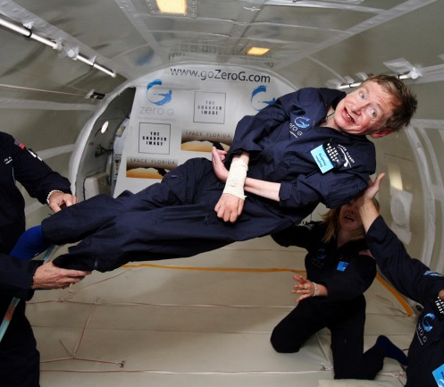
Miscellaneous facts
Hawking married twice, and has three children with his first wife
His original diagnosis at age 21 gave him two years to live – however, he is still alive and active in the science community 50 years later
Known for brashness, wit, partying into the wee hours of the morning, and “[wild] wheelchair driving”
The computer program in Hawking’s wheelchair, known as the “Equalizer”, allows the user to choose from a bank of words and phrases with a switch
Hawking prefers his computer to speak with an American accent, rather than with his native British accent
Is “not religious” but debates the presence of (a) God
Interested in modern philosophy and its relationship with the sciences

