Slide 1
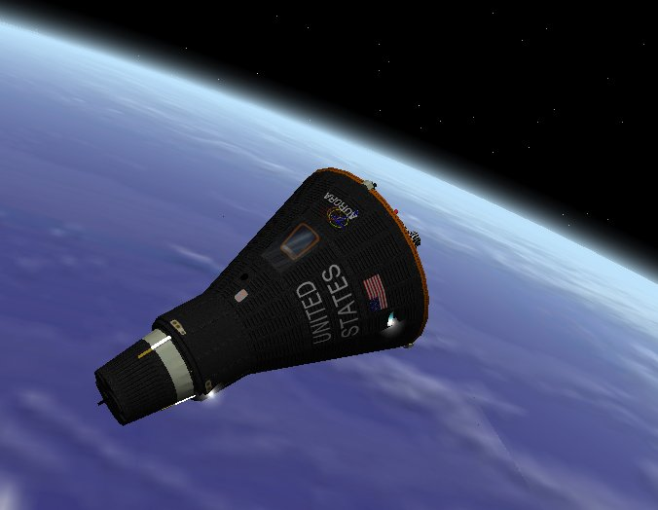
How Far in the Future
Certain Humans can Go
Weak Human- 1g force
Normal Human- 3g force
Strong Human- 6g force
*3 years is about how long an average human can stay in an enclosed space capsule (before going
completely insane)*

Slide 2
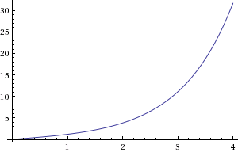
Weak Human (Grandma)

Slide 3
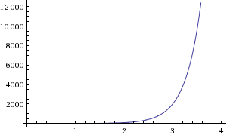
Normal Human

Slide 4
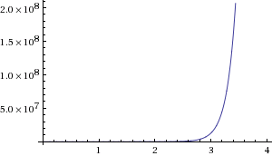
Strong Human (Best of the
Best Astronaut)

