Slide 1
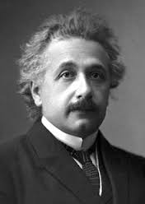
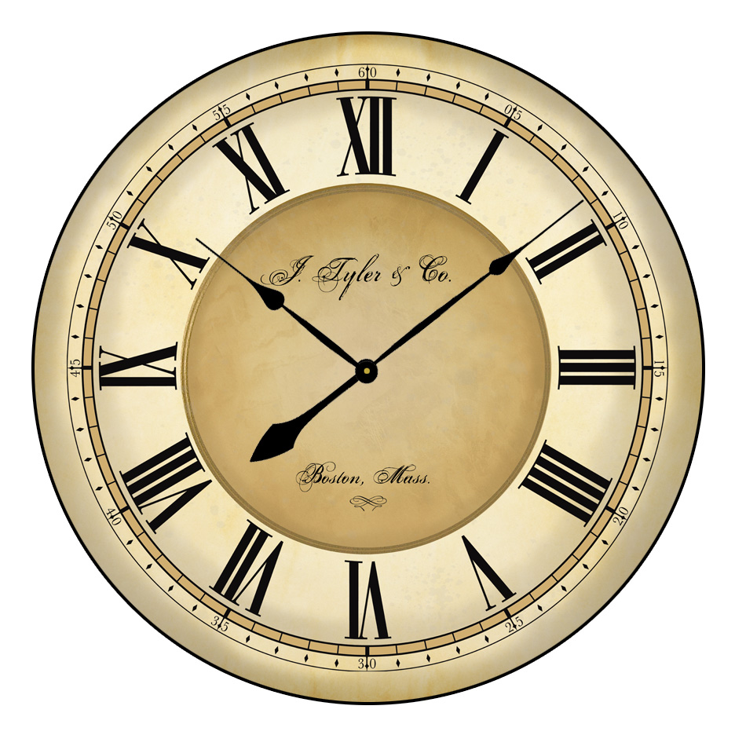
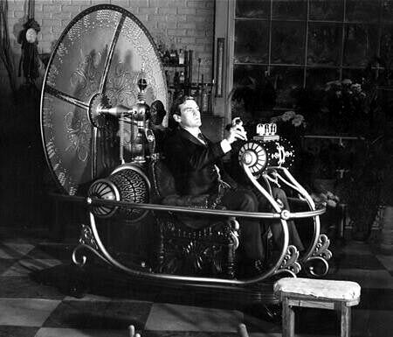
Changing perceptions of time with and prior to relativity and time speculations in science fiction

Slide 2
SPOILER ALERT

Slide 3
Original perception
Time was originally thought of as a way to measure the order and frequency of events
It had a direction, and our perception of it was correct, universal, and irreversible
At the same time, 3 dimensions were thought of as the absolute only dimensions because we could only freely perceive those

Slide 4

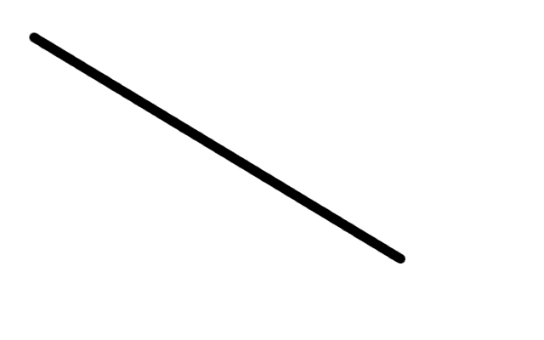

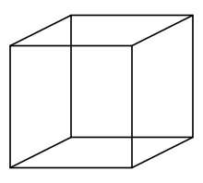
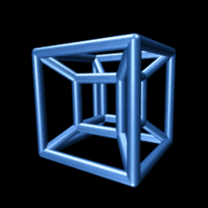
1800s
During the 1800s, a new theory of dimensionality emerged, although it was impossible for us to properly perceive it, objects existed in four dimensional space
A figure called the tesseract was created which drew off of geometric algorithms to show a visualization of a 4 dimensional figure
By the late 1800s, it became fairly well accepted that the fourth dimension was time

Slide 5
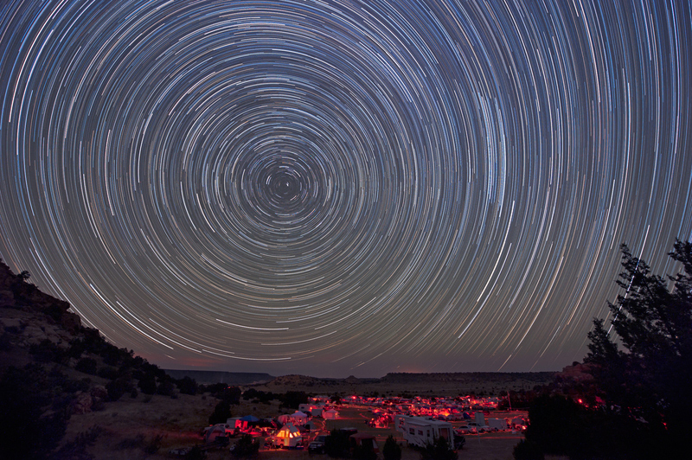

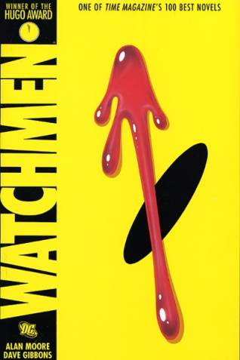
What this means
This means that all of time exists simultaneously, even though we experience it in a particular direction
Events do not occur, they are simply present in the plane of causality
In the late 60s, Kurt Vonnegut wrote a novel called slaughterhouse five with beings who perceived time this way
Later, Alan Moore pursued a similar concept through the character Jon Osterman in his graphic novel watchmen

Slide 6

Then along comes Einstein…
Then along comes Einstein, just when we have accepted time as an untouchable 4th dimension, and he makes everything even more confusing
According to Einstein, time is different at different velocities and in different gravitational fields
So those things we think we understand are fundamentally linked to concepts out of our reach
Once space and time are united, the original causal model of a four dimensional universe is challenged

Slide 7
Time travel
Although Einstein’s theory of relativity only describes time moving slower or faster, many speculate this could also be applied to going backwards and forwards in time
The way backwards time travel alters our vision of causality leads to two possible conclusions, either going back in time has a huge potential to create paradoxes and causality loops
Or when a paradox is formed, the other time line still exists, but the future you’ve created becomes a parallel universe

Slide 8
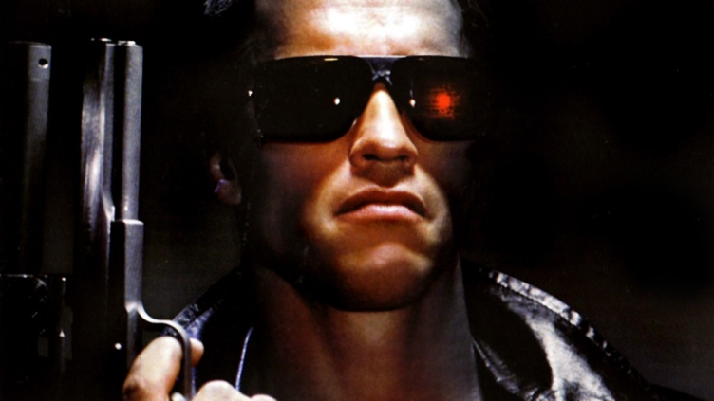
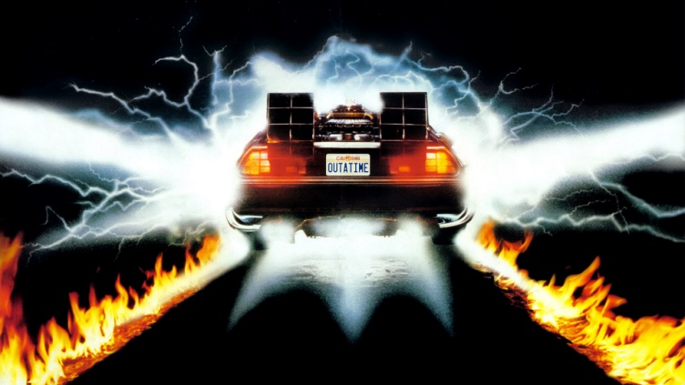
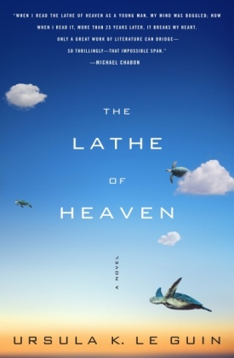
In fiction
The first type is seen in movie such as the terminator, in which time travel is along the same path and a causality loop is formed
The second is seen in the movie back to the future two, in which changes are made to the past, and a parallel future splits off
The second concept, though less popular, makes more logical sense, and its necessitation for parallel universes can be applied in reverse as in the lathe of heaven by ursula k. leguin

