Slide 1
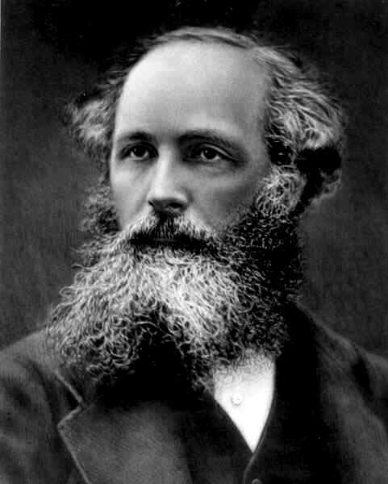
James Clerk Maxwell
1831-1879

Slide 2
Early Life 1831-1847
Maxwell was always recognized as a smart one
Always curious
Taught by mother and tutor before school

Slide 3
Edinburgh Academy
He was very successful in math and english
Not recognized by the school for his genius till 13
At 14 wrote paper on ellipses and curves.
At 18 wrote a couple more about assorted things- never was allowed to present or be credited with ideas

Slide 4
Edinburgh University 1847-50
Learned some physics and natural philosophy
Had lots of free time for self interests and projects.
Worked a lot with light

Slide 5
Cambridge 1850-6
Math degree from Trinity
Worked a lot on color- found red green and blue light combined make white light.

Slide 6
Aberdeen University 1856-60
Did work on Saturn’s rings. Won Adams prize.
Only one who even made headway
Was confirmed as correct by Voyager

Slide 7
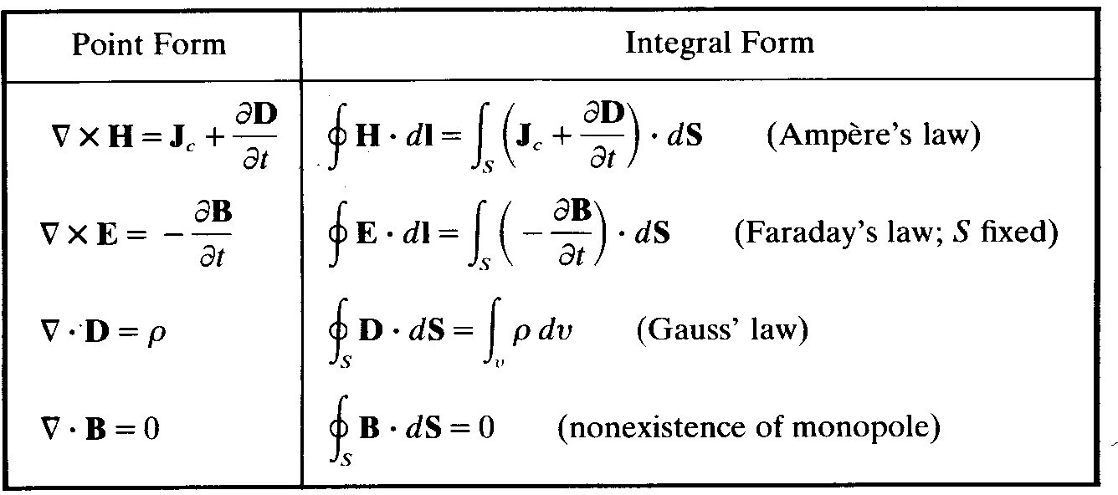
Kings College 1860-5
Did most of his work on electromagnetism:
  Unification of light electricity and magnetism
    Displacement current
    Electromagnetic induction
    Polarization of light
    Etc.

