Slide 1
The Duality of Light
Particular and Wavelike
Kristine Lister

Slide 2
Early Findings 1670’s
Christian Huygens: points on a wave as new sources
Isaac Newton: corpuscular theory

Slide 3
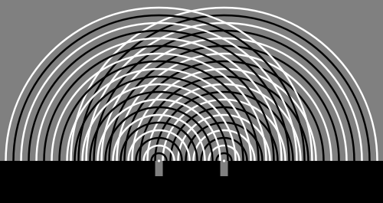
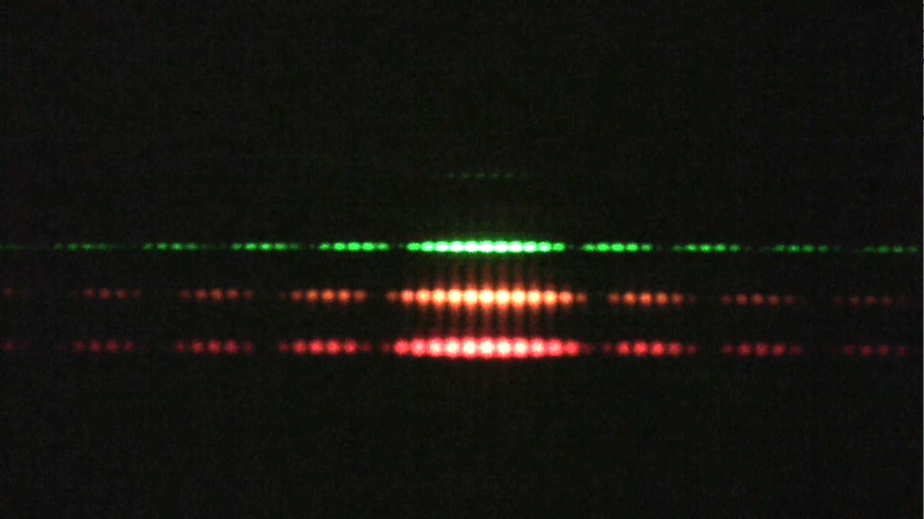
Young’s Double Slit Diffraction

Slide 4
Late 1800’s to Early 1900’s
James Clerk Maxwell: light is electromagnetic
Max Planck: spectrum of light emitted by a glowing object
Einstein looked at the photoelectric effect

Slide 5
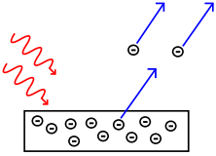
Photoelectric Effect
Light will hit a material and shed electrons which induce a current

Slide 6
Photons
Discrete quanta (packets) of energy with particular qualities
E = hf
Photoelectric effect: E = hf – φ
Einstein wins Nobel prize in 1921

Slide 7

de Broglie Wavelength
All matter moved as waves
λ= $\frac{h}{p}$
1929 Nobel Prize
Thomson and Davisson experiment with electron diffraction patterns
1937 Nobel Prize

Slide 8
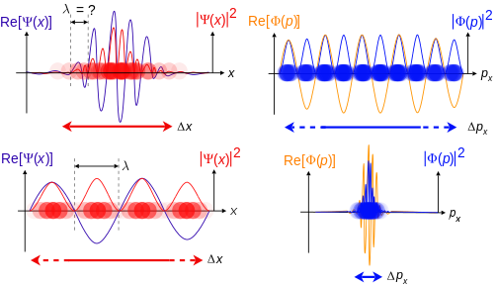

Heisenberg Uncertainty Principle
Developed from de Broglie’s hypothesis
ΔxΔp $≥$ $\frac{\text{ħ}}{2}$

Slide 9
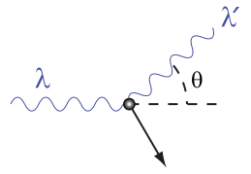

Today
Developed from de Broglie’s hypothesis
  ΔxΔp ≥ $\frac{ħ}{2}$
Wave Function (Ѱ)
  Quantum state of a particle over time
  Ex: Schrodinger equation
Compton Wavelength
  Electron collide and sheds a photon
  Δλ = $\frac{h}{m_{e}c}$(1 - cosϴ)

