Slide 1
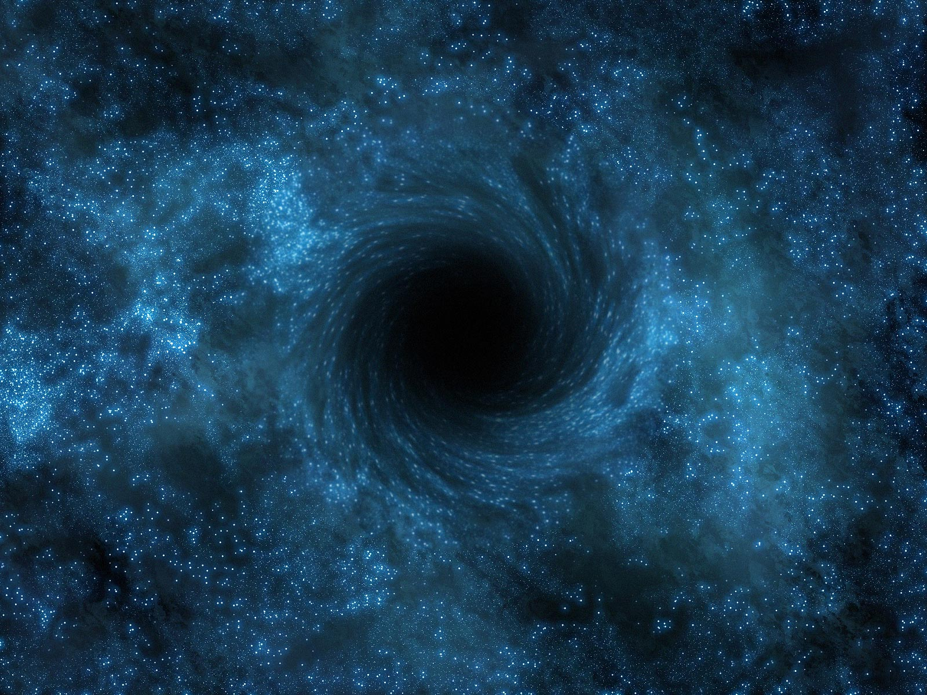
Black Holes
By Irina Plaks

Slide 2
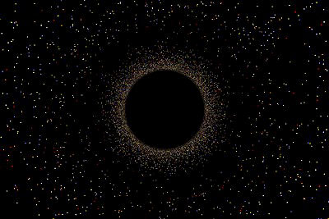
What is a black hole?
A black hole is a region in spacetime where the gravitational field is so strong that nothing, not even light, can escape it.

Slide 3
Black Holes and the General Theory of Relativity
The physical properties of black holes can be explained by the general theory of relativity.
According to general relativity, matter tends to “warp” or curve the space near it.
The greater the mass, the greater the warping.
Objects follow the curvature off space produced by a nearby massive object.
Near a black hole, the gravitational field becomes so strong, and the curvature of space is so great, that space “folds over” on itself, causing objects within to become trapped.
Information slows down while moving towards the black hole, and is lost in the black hole.

Slide 4
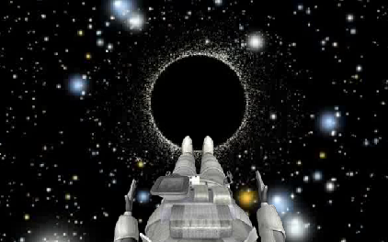
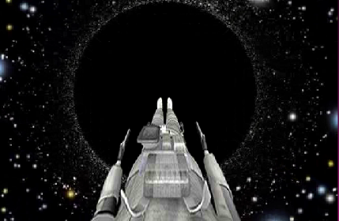
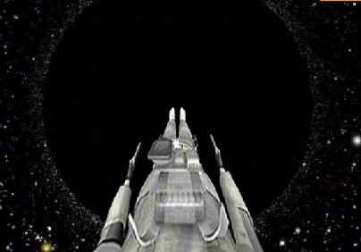
Tidal Forces in a Black Hole
Matter flowing into a black hole is subject to great tidal stress.
Someone falling into black hole would be stretched enormously in height, and compressed in width.
The person would be torn apart before even reaching the event horizon because the pull of gravity would be a lot stronger at the person’s feet than at his head.
The result of everything that falls into the black hole being stretched and compressed is numerous and violent collisions among the debris, which causes a lot of frictional heating of the matter.
The debris is torn apart and heated to high temperatures as it falls into the black hole.

Slide 5
Tidal Forces in a Black Hole
The falling matter reaches such high temperatures that it emits radiation.
For a black hole with a mass similar to that of the sun, the energy emitted is expected to be in the form of X- rays.
The gravitational energy of matter outside the black hole is converted into heat as the matter falls towards the black hole.
This makes the region surrounding a black hole a source of energy.
Once the matter falls below the event horizon, its radiation is no longer detectable.

Slide 6
Gravitational Redshift
Let’s suppose a spaceship sent a light-emitting probe or a robot into a black hole, and the people on the spaceship measured the frequency of the light received.
They would find that that the light would become more and more redshifted as the probe neared the event horizon.
The redshift is caused by the black hole’s gravitational field.
This was predicted by Einstein’s general theory of relativity and is known as the gravitational redshift.

Slide 7
Gravitational Redshift
Explanation of the redshift:
  According to general relativity, photons are attracted by gravity.
  As a result, photons have to use energy in order to escape from a source of gravity.
  The photons don’t slow down, they just lose energy.
  Because a photon’s energy is proportional to its frequency, as light loses energy, its frequency is also reduced.

Slide 8
Gravitational Redshift
From the point of view of the spaceship, a green light sent by the probe would become yellow, and then red as the probe nears the black hole.
From the probe’s perspective, the light would stay green.
As the probe got closer to the event horizon, the radiation from its light source would no longer be visible light.
The radiation reaching the orbiting spacecraft would be lengthened so much that it would be in the form of infrared and radio waves.
Even closer to the event horizon, the radiation originally emitted as visible light from the probe would be shifted to wavelengths even longer than conventional radio waves by the time it reached the spaceship.

Slide 9
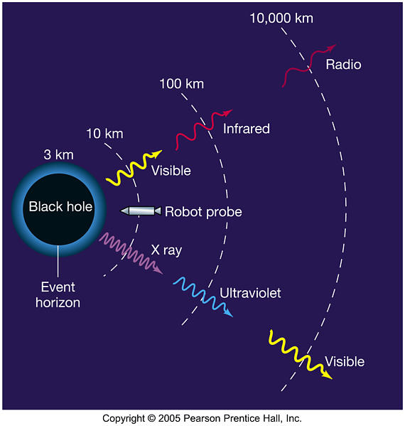

Slide 10
Gravitational Redshift
Light emitted from the event horizon would be gravitationally redshifted to infinitely long wavelengths. Each photon would use all its energy trying to escape from the edge of the black hole.
What was once light would have no energy left by the time it reached the spaceship.
Theoretically, this radiation would still reach it, still moving at the speed of light, but with zero energy.
The light radiation originally emitted would be redshifted beyond perception.

Slide 11
Black Holes in Binary Systems
There are some binary systems (a system with two object so close together that each other’s gravity causes them to orbit around a common place) that suggest one of the two members may be a black hole.
Some observations made in the 1970-80’s revealed binary systems in which the invisible member emits large amounts of X-rays.
The mass of the emitting object is measured as several solar masses, so it is not a small, dim star that can’t be seen.
And the possibility of it being hidden by debris is also unlikely.
The X-ray emitting regions can be accretion disks formed as matter drawn from the visible star spirals down onto the invisible object.

Slide 12
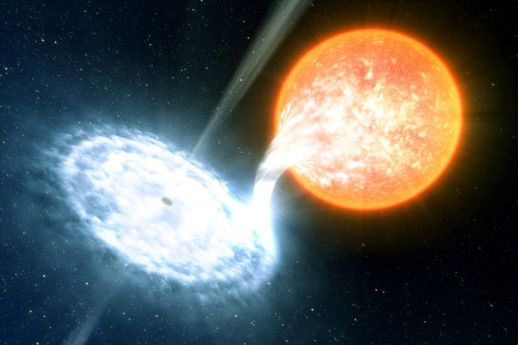

Slide 13
Black Holes in the Centers of Galaxies
Astronomers have found that stars and gas near the centers of many galaxies are moving extremely rapidly, orbiting some very massive, unseen object.
The inferred masses of these objects range from millions to billions of times the mass of the Sun.
Intense energy emissions from the centers of these galaxies, and fluctuations in those emissions, suggest the presence of massive, compact objects.
Astronomers believe these to be supermassive black holes.

Slide 14
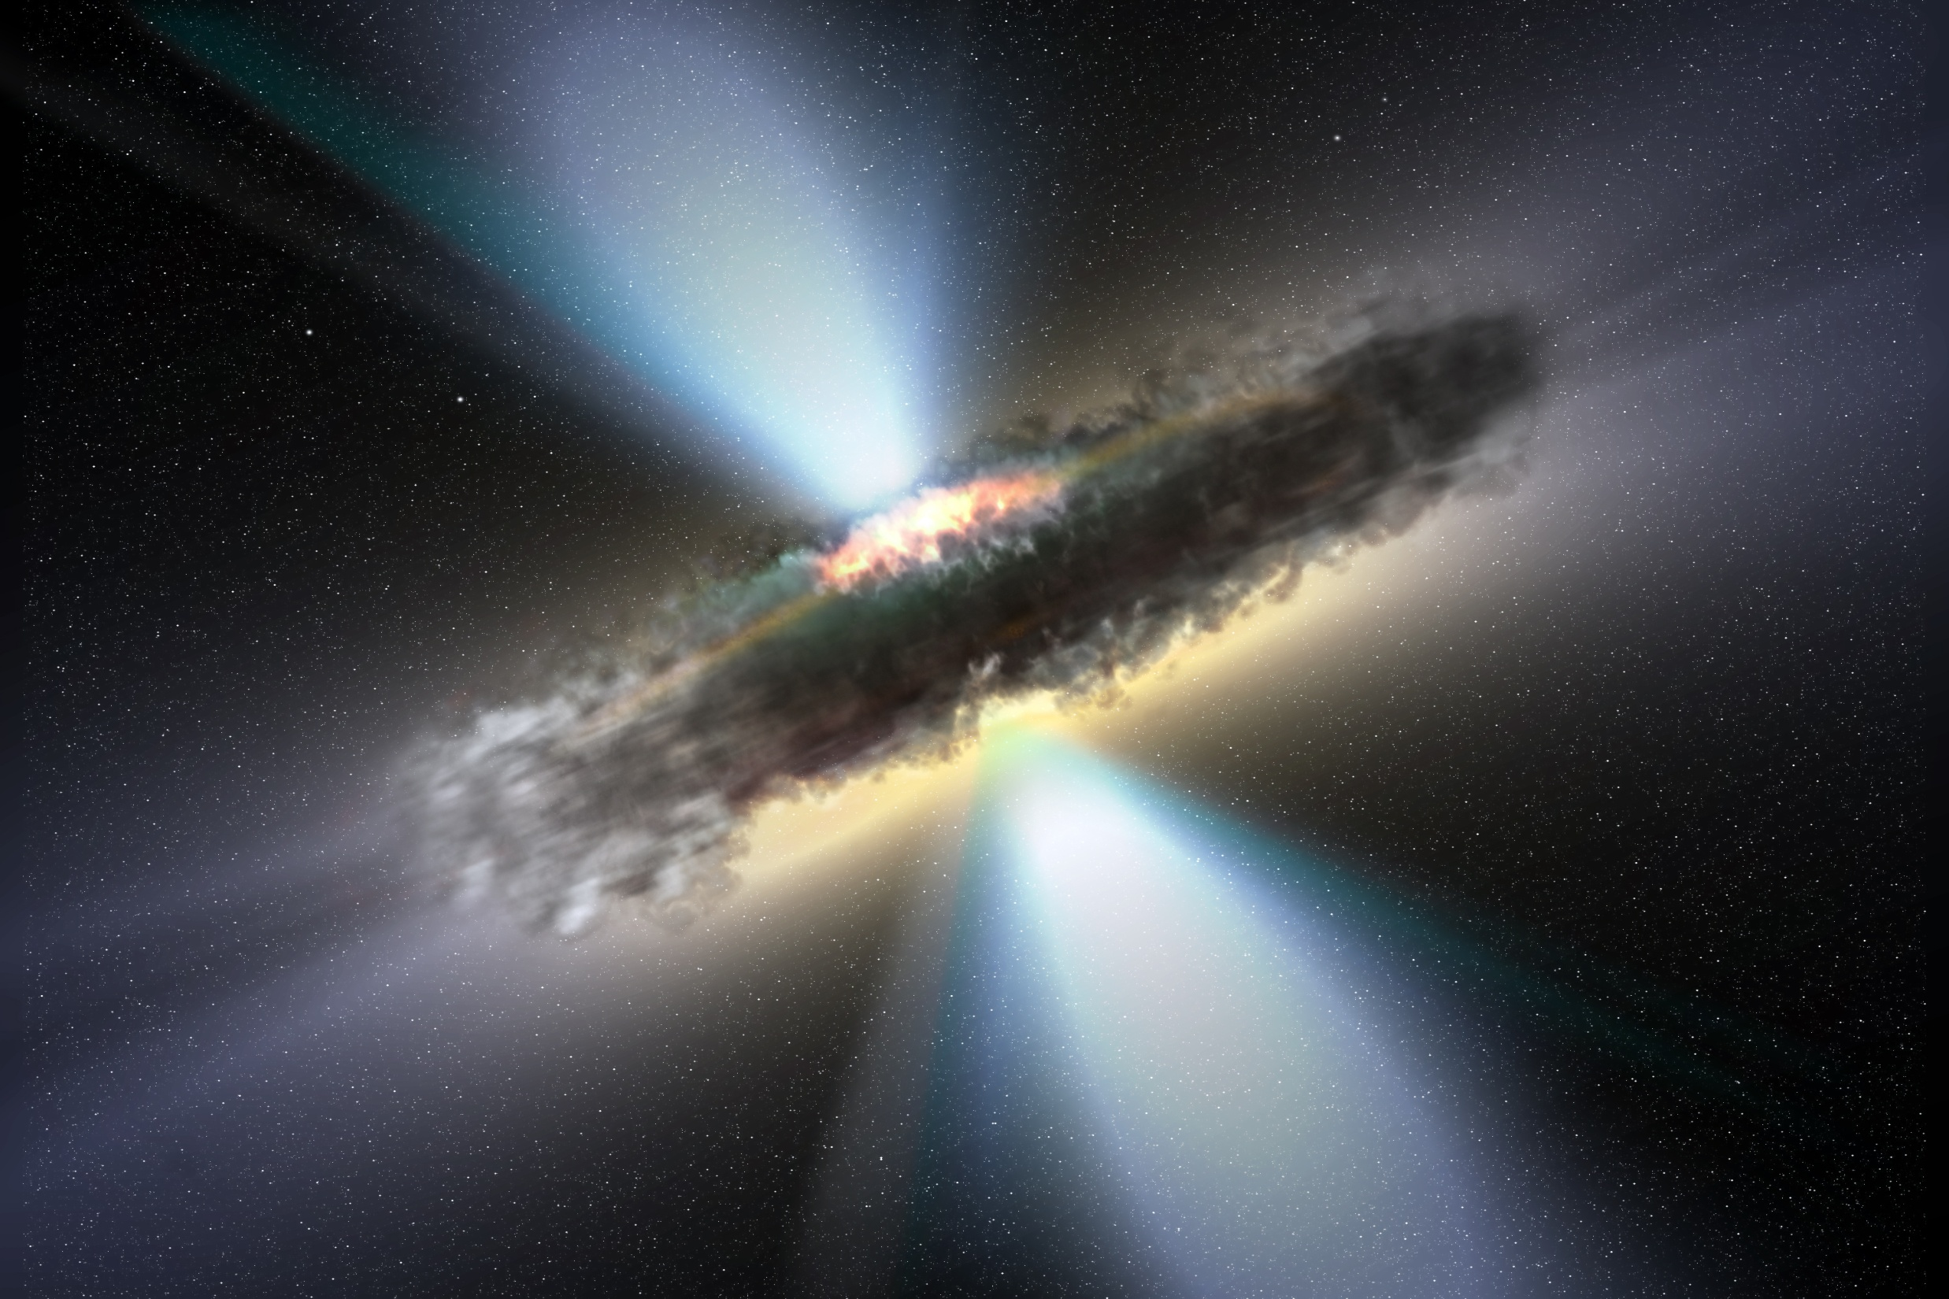

Slide 15
Terms
Ergosphere - a region outside the event horizon, where gravitational forces start to influence objects’ movements. Objects here can no longer remain stationary in space.
Photon Sphere - a location where gravity is so strong that light can travel in circles. Photons orbit the black hole at the distance of the photon sphere. (If you look in a mirror, you can see the back of your head).

Slide 16
Further Information
Black holes and the Universe by Igor Novikov
Black holes : an Introduction by Derek J. Raine
Introduction to Black Hole Physics by V. P. Frolov and Andrei Zelnikov

