Slide 1
The String Theory
The Universality of Physics
By: Won S. Oh

Slide 2

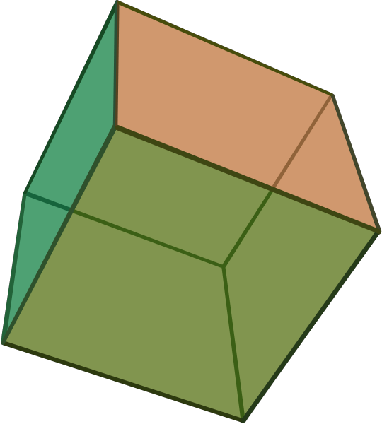
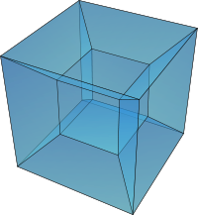
Spatial Dimensions in Physics
Dimension | 0th | 1st | 2nd | 3rd | 4th
 | A dot | A line | A square | A cube | A tesseract—cubic world with “time”

Slide 3
The Physical Forces – Fundamental interactions
Interactions | Current Theory | Mediators | Relative Strength | Long distance Behavior | Range (m)
Strong | Quantum Chromodynamics (QCD) | gluons | 10²⁸ | 1 | 1.4 * 10⁻¹⁵
Electromagnetic (EM) | Quantum Electrodynamics (QED) | photons | 10³⁶ | 1/r² | 10⁴⁵
Weak | Electroweak | W & Z Bosons | 10²⁵ | e^{–m W,Z r}/r | 10⁻¹⁷
Gravitation | General Relativity | gravitons | 1 | 1/r² | INFINITY
http://hyperphysics.phy-astr.gsu.edu/hbase/forces/funfor.html

Slide 4
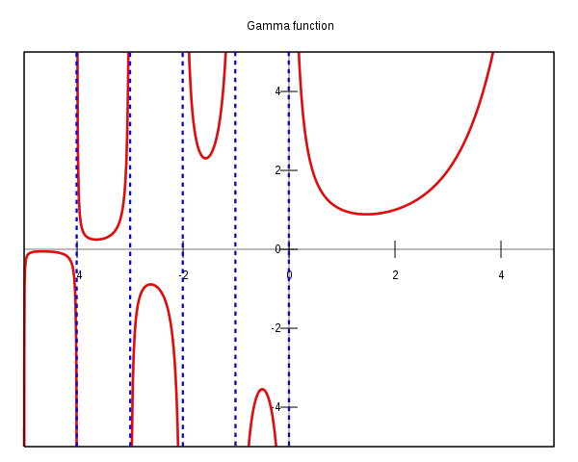


The Accidental Discovery
Gabriele Veneziano, an Italian theoretical physicist in CERN, “accidentally” founded the field of string theory while going through the Euler’s mathematical functions.

Slide 5
Particles
What are particles?
  Mainly viewed as points (0th Dimension)

Slide 6
Classical Mechanics
Modern Physics
Newton, the significant contributor
Based on Observations
Explained how our “world” functions
Calculus founded for calculations

Slide 7
THE MODERN PHYSICS – Dealing with the microscopic world
The modern physics required something “new”
  General Relativity
  Quantum Mechanics
  Condensed Matter
  Nuclear and Atomic Physics

Slide 8
Particles… Again
Instead of dots
The Strings

Slide 9
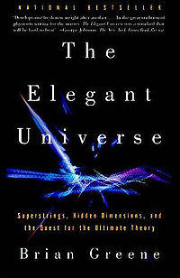
The Contributors to String Theory
Michael Duff
Michael Green
Brian Greene
Alexander Polyakov
Gabriele Veneziano
Please also read

