Slide 1
Tensors
By Matthew Dannenberg

Slide 2
What are Tensors?
Classified by:
Rank → n
Dimension → m
m^{n} elements in each tensor
Rank 2
Matrix/Dyad
Rank 1
Vector
Rank 0
Scalar
0 -E_{x}/c -E_{y}/c -E_{z}/c
E_{x}/c 0 B_{z} -B_{y}
E_{y}/c -B_{z} 0 B_{x}
E_{z}/c B_{y} -B_{x} 0
ct
x
y
z
a
Electromagnetism tensor

Slide 3
Use in General Relativity
Einstein’s Field Equation
R_{ab}-(1/2)Rg_{ab}=kT_{ab}
Einstein Tensor = left side of equation
Ricci Tensor = R
Metric Tensor = g
Energy-Momentum Tensor = T
k = 8лG/c⁴

Slide 4
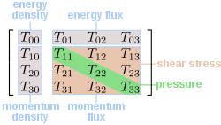
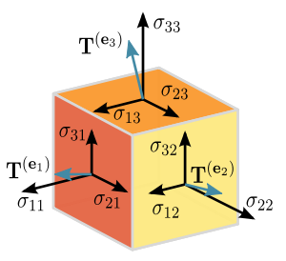

Some Tensors
Stress-energy or energy-momentum tensor
Stress Tensor

Slide 5
Dyad Product
A simple example of a tensor operation
abcd
Aa Ba Ca Da
Ab Bb Cb Db
Ac Bc Cc Dc
Ad Bd Cd Dd
A B C D
In general, two tensors of rank n and m can be combined to form a tensor of rank n+m.

