Slide 1
Dark Energy

Slide 2
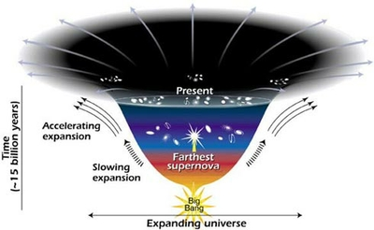
Expansion of the Universe
Early 1990’s – Universal expansion expected to slow
- Universe is full of matter, and gravity pulls matter together
1998 – Hubble Space Telescope observations show otherwise
- Observations of Type LA supernovae show expansion is accelerating
The Great Rip

Slide 3
Confusion + Dark energy
Many theories attempt to explain this acceleration
None are accepted as fact, but the solution is called Dark Energy
Not much is known about Dark Energy
- Universal composition
- Debate about whether it is a particle, or a field
- And… nothing else.

Slide 4
Current Theories
Theory #1: Empty space has its own energy (cosmological constant)
Theory #2: Quantum Theory of Matter
Theory #3: Quintessence
Theory #4: Einstein was wrong

Slide 5
Theory #1: Cosmological Constant
Einstein believed that Constant existed to stop Universal collapse
- Theory discarded
Theory #1 predicts empty space has energy of its own
- No dilution due to Universal Expansion
- As more space appears, more energy appears to drive expansion
Problem: nobody knows why this energy would exist

Slide 6
Theory #2: Quantum Theory of matter
Empty space is not actually empty
- It’s full of temporary particles
These particles would grant the empty space energy
Problem: calculations show that there would be too much energy

Slide 7
Theory #3: Quintessence
Dark Energy is some sort of fluid
This field fills the Universe, but has the opposite effect on its expansion than normal matter/energy
- It has a negative gravitational mass

Slide 8
Theory #4: Einstein is wrong
Einstein’s theory of gravity is wrong

Slide 9
JDEM
Joint Dark Energy Mission
JDEM attempts to find out more about Dark Energy
Not much success…

Slide 10
Works Cited
"HubbleSite - NewsCenter - Blast from the Past: Farthest Supernova Ever Seen Sheds Light on Dark Universe (04/02/2001) - Release Images." HubbleSite - Out of the Ordinary...out of This World. NASA. Web. 06 July 2011. <http://hubblesite.org/newscenter/archive/releases/2001/09/image/g/>.
"Dark Energy - Introduction." Imagine The Universe! Home Page. Goddard Space Flight Centre. Web. 07 July 2011. <http://imagine.gsfc.nasa.gov/docs/science/mysteries_l1/dark_energy.html>.

