Slide 1
Albert Einstein

Slide 2
Introduction
Albert Einstein was born on March 14, 1879 in Germany.
He is widely known as the physicist who developed the theory of General relativity.
Einstein also expanded on general relativity and developed the theory of special relativity.
These are the two most popular accolades associated with Albert Einstein
Einstein also lived to see world war two, he alerted Franklin D. Roosevelt, the president at that time, that Germany might be constructing an atomic weapon.
This expanded into the Manhattan project, even though Einstein was strongly against using nuclear fission as a weapon.

Slide 3
Introduction
Many people see Einstein as the person that invented the theory of relativity.
Most don’t know though, that Einstein did researched extensively on subjects dealing with photoelectric effects and thermodynamics.
Einstein actually received his Nobel prize from recognizing a phenomenon known as the photoelectric effect.
This is basically when a type of energy such as ultraviolet rays hits an electron-dense object such as metal, electrons break apart from the surface in rays.

Slide 4
Unification of topics
Einstein actually combined these two topics, he reconciled Maxwell’s equations for electricity and magnetism with the laws of mechanics by introducing major changes to mechanics close to the speed of light.
He hypothesized that the speed of light is independent of the frame of reference of an observer from a different frame.
Through various calculations, Einstein disproved the existence of a “luminiferous Ether Wind”

Slide 5
Unification of topics
At the start of his scientific work, Einstein realized the inadequacies of Newtonian mechanics and his special theory of relativity stemmed from an attempt to reconcile the laws of mechanics with the laws of the electromagnetic field.
This led to an explanation of the Brownian movement of molecules. He investigated the thermal properties of light with a low radiation density and his observations laid the foundation of the photon theory of light.
He later connected this with relativity and formed special relativity.

Slide 6
Einstein’s “wormholes”
Einstein collaborated with a number of others to produce a model of a wormhole.
He worked on a project that hypothetically assumed that wormholes were possible
He concluded that if one end of a wormhole was positively charged, the other was negatively charged

Slide 7
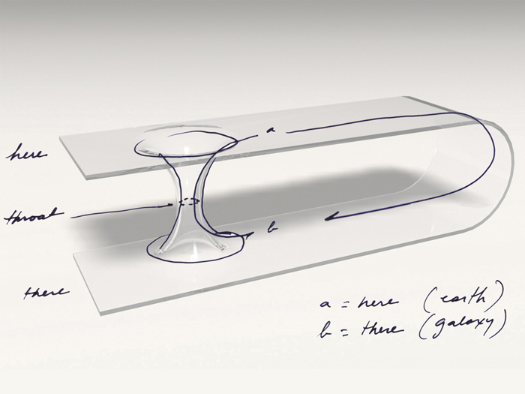

Slide 8
Further attempts at unification
In his quest for unification of electromagnetism and the geometric theory of gravitation, Einstein developed Unified Field Theory.
He even wrote a book on this connection, but afterwards became increasingly isolated in his research.
Many don’t understand why, but Einstein may have not been satisfied with this theory.
His attempts, however, motivated quests on string theory, where geometrical fields emerge in a unified quantum-mechanical setting.

